Slide 1

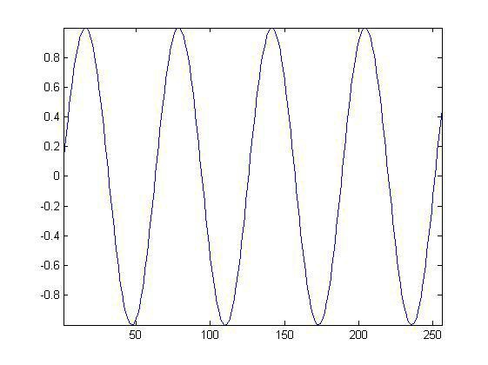
Signal Processing
Lec. 1
Signals and Systems
  Introduction:
The concept and theory of signals and systems are needed in almost all electrical engineering fields and in many other engineering and scientific disciplines as well. In this lecture, we introduce the mathematical description and representation of signals and systems and their classifications. We also define several important basic signals essential to our studies.
  Signals And Classification Of Signals
A signal is a function of independent variables such as time, distance, position, temperature and pressure. Mathematically, a signal x(t) represents a function of an independent variable t. Usually t represents time. A signal carries information, and the objective of signal processing is to extract useful information carried by the signal. Signal processing is concerned with the mathematical representation of the signal and the algorithmic operation carried out on it to extract the information present.
Classification of signals:
A. Continuous-Time and Discrete-Time Signals:
Continuous time signal: a signal that is specified for every real value of the independent variable. The independent variable is continuous, that is it takes any value on the real axis. The domain of the function representing the signal has the cardinality of real numbers.
Signal ↔ f=f(t)
Independent variable ↔ time (t), position (x) For continuous-time signals: t ∈ R
amplitude
time
Discrete time signal: a signal that is specified only for discrete values of the independent variable. It is usually generated by sampling so it will only have values at equally spaced intervals along the time axis. The domain of the function representing the signal has the cardinality of integer numbers.
Signal ↔ f=f[n], also called “sequence” Independent variable ↔ n
For discrete-time functions: t ∈Z

Slide 2
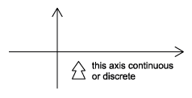
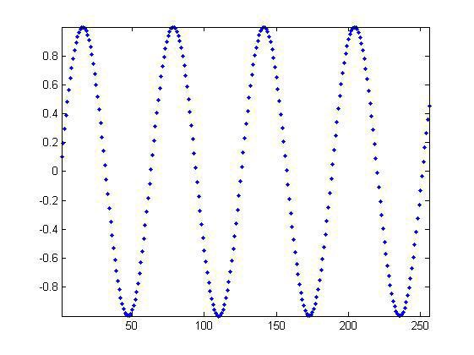
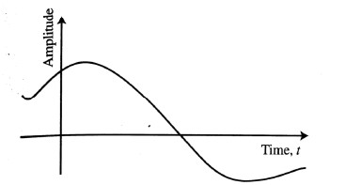
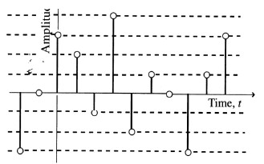
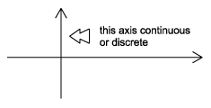
Signal Processing
Lec. 1
B. Analog and Digital Signals:
analog signal :A continuous-time signal with a continuous amplitude. A speech signal is an example of an analog signal.
digital signal :A discrete time signal with discrete valued amplitudes represented by a finite number of digits .
Real and Complex Signals: A signal x(t) is a real signal if its value is a real number, and a signal x(t) is a complex signal if its value is a complex number. A general complex signal x ( t )is a function of the form:
x ( t ) = x1 ( t ) + i x2 ( t )
where x1( t ) and x2( t ) are real signals and i = √−1 .
t represents either a continuous or a discrete variable.
Deterministic and Random Signals:
Deterministic signal: deterministic signal is a signal in which each value of the signal is fixed and can be determined by a mathematical expression, rule, or table. Because of this the future values of the signal can be calculated from past values with complete confidence. Examples: signals defined through a mathematical function or graph.
Probabilistic (or random) signals: is a signal in which the amplitude values cannot be predicted precisely but are known only in terms of probabilistic descriptors. The future values of a random signal cannot be
accurately predicted and can usually only be guessed based on the averages of sets of signals.

Slide 3
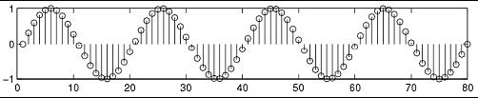


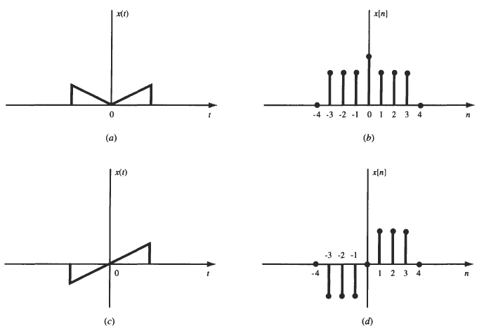
Signal Processing
Lec. 1
deterministic signal
random signal
E. Even and Odd Signals:
A signal x ( t ) or x[n] is referred to as an even signal if
A signal x ( t ) or x[n] is referred to as an odd signal if
x ( - t ) = x ( t ), x [ - n ] = x [ n ]
x ( - t ) = - x ( t ), x [ - n ] = - x [ n ]
(a and b ) even signals and (c and d) odd signals
F. Periodic and Non periodic Signals:
periodic Signal: A continuous-time signal x ( t ) is said to be periodic with period T0 if there is a positive nonzero value of T0 for which
f (t +T0 ) = f (t) ∀t
Any continuous-time signal which is not periodic is called a nonperiodic (or aperiodic )

Slide 4
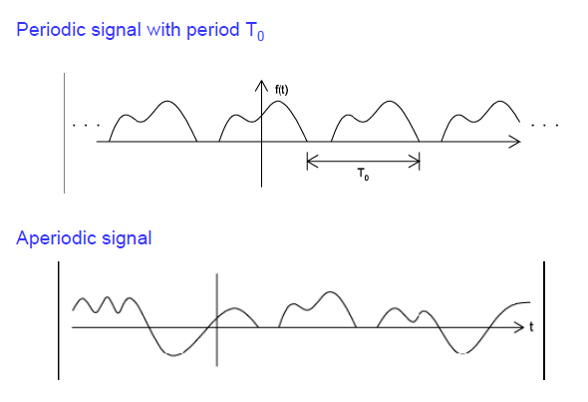
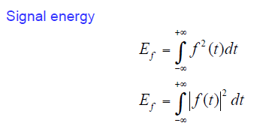

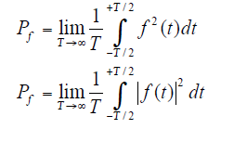


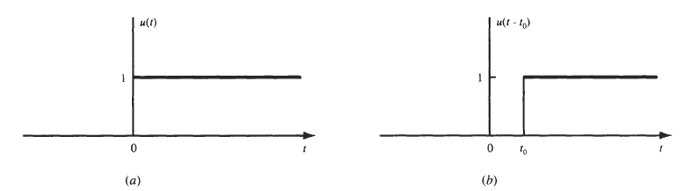


Signal Processing
Lec. 1
G. Energy and Power Signals:
Power signal
1.3 Basic Continuous-Time Signals
A. The Unit Step Function:
The unit step function u(t), also known as the Heaciside unit function, is defined as
which is shown in Fig. (a). Note that it is discontinuous at t = 0 and that the value at t = 0 is undefined. Similarly, the shifted unit step function u(t - to) is defined as
which is shown in Fig. (b).
B. The Unit Impulse Function:
The unit impulse function 𝛿(t), also known as the Dirac delta function, plays a central role in system analysis. Traditionally, 𝛿(t) is often defined as the limit of a suitably chosen conventional function having unity area over an infinitesimal time interval and possesses the following properties:

Slide 5
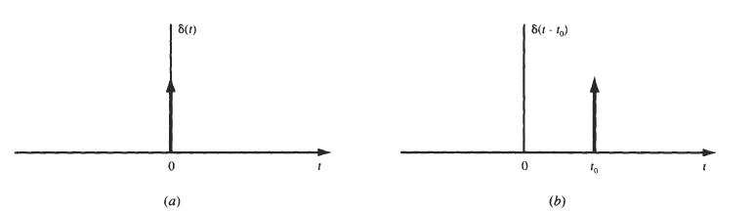
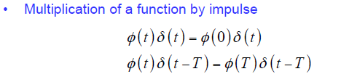
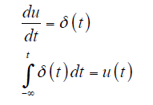
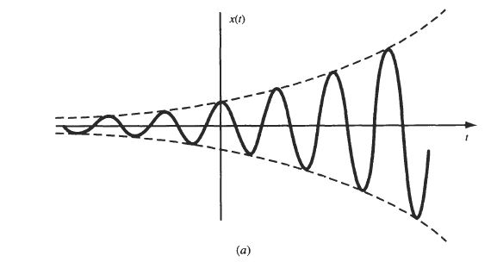
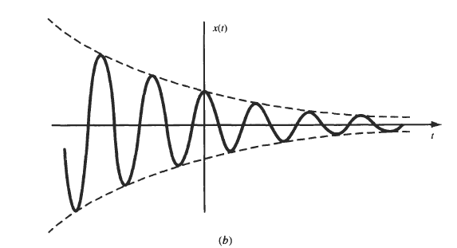


Signal Processing
Lec. 1
Properties of the unit impulse function:
•
The unit step function is the integral of the unit impulse function
C. Complex Exponential Signals:
The complex exponential signal �(𝒕) = 𝒆^{𝒋�°𝒕}is an important example of a complex signal.
(a) Exponentially increasing sinusoidal signal
(b) exponentially decreasing sinusoidal signal
D. Sinusoidal Signals:
A continuous-time sinusoidal signal can be expressed as:
where A is the amplitude (real), w0 is the radian frequency in radians per second, and 𝜃is the phase angle in radians. The sinusoidal signal x(t) is shown in Figure, and it is periodic with fundamental period

Slide 6
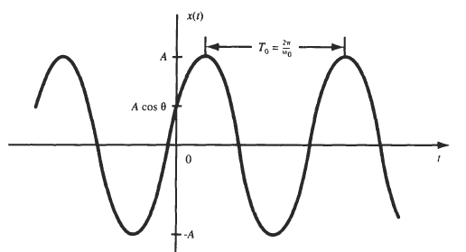


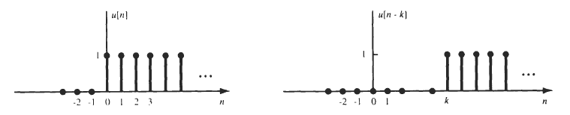


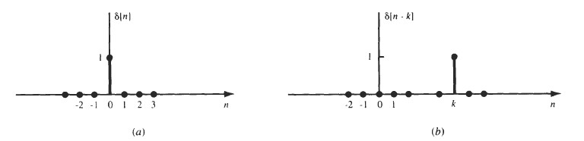
Signal Processing
Lec. 1
1.4 Basic Discrete-Time Signals
A. The Unit Step Sequence:
The unit step sequence u[n] is defined as
which is shown in Fig. (a). Similarly, the shifted unit step sequence u[n - k] is defined as which is shown in Fig. (b).
(a)
(b)
B. The Unit Impulse Sequence:
The unit impulse (or unit sample) sequence 𝛿[n] is defined as
which is shown in Fig. (a). Similarly, the shifted unit impulse (or sample) sequence 𝛿[n - k] is defined as
which is shown in Fig. (b)

Slide 7




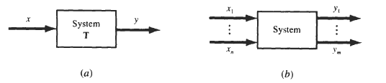
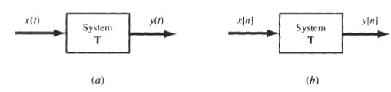
Signal Processing
Lec. 1
C. Complex Exponential Sequences:
The complex exponential sequence is of the form
using Euler's formula, x[n] can be expressed as
D. Sinusoidal Sequences:
A sinusoidal sequence can be expressed as
have units of radians.
If n is dimensionless, then both Ω°, and 𝜃
1.5 Systems And Classification Of Systems
A. System Representation:
A system is a mathematical model of a physical process that relates the input (or excitation) signal to the output (or response) signal. Let x and y be the input and output signals, respectively, of a system. Then the system is
viewed as a transformation (or mapping) of x into y. This transformation is represented by the mathematical notation … (a)
where T is the operator representing some well-defined rule by which x is transformed into y. Relationship (a) is depicted as shown in Fig. (a). Multiple input and/or output signals are possible as shown in Fig. (b). We will restrict our attention for the most part in this text to the single-input, single-output case.
System with single or multiple input and output signals
B. Continuous; Time and Discrete-Time Systems:
If the input and output signals x and y are continuous-time signals, then the system is called a continuous- time system [Fig. (a)]. If the input and output signals are discrete-time signals or sequences, then the system
is called a discrete-time system [Fig. (b)].
(a) Continuous-time system; (b) discrete-time system

Slide 8






Signal Processing
Lec. 1
C. Systems with Memory and without Memory
A system is said to be memoryless if the output at any time depends on only the input at that same time. Otherwise, the system is said to have memory. An example of a memoryless system is a resistor R with the input x ( t ) taken as the current and the voltage taken as the output y ( t ) . The input-output relationship (Ohm's law) of a resistor is
An example of a system with memory is a capacitor C with the current as the input x( t ) and the voltage as the output y ( t) ; then
A second example of a system with memory is a discrete-time system whose input and output sequences are related by
D. Causal and Noncausal Systems:
A system is called causal if its output y ( t ) at an arbitrary time t = t0, depends on only the input x ( t ) for t
≤ 𝒕o. That is, the output of a causal system at the present time depends on only the present and/or past values of the input, not on its future values. Thus, in a causal system, it is not possible to obtain an output before an
input is applied to the system. A system is called noncausal if it is not causal. Examples of noncausal systems are:
E. Linear Systems and Nonlinear Systems:
If the operator T in Eq. (a) satisfies the following two conditions, then T is called a linear operator and the system represented by a linear operator T is called a linear system:
1. Additivity:
Given that Tx1= y1, and Tx2= y2,
…(a)
then
T(x1 +x2) =y1 +y2
…(b)
for any signals x1 and x2.
2. Homogeneity (or Scaling):
….(c)
for any signals x and any scalar 𝛼.
Any system that does not satisfy Eq. (b) and/or Eq. (c) is classified as a nonlinear system. Equations (b) and (
c) can be combined into a single condition as:

Slide 9




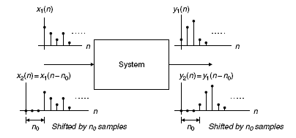


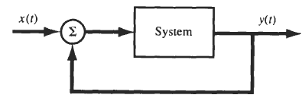
Signal Processing
Lec. 1
Examples of nonlinear systems are:
Time-Invariant and Time-Varying Systems:
A system is called time-invariant if a time shift (delay or advance) in the input signal causes the same time shift in the output signal. Thus, for a continuous-time system, the system is time-invariant if
… d
for any real value of T. For a discrete-time system, the system is time-invariant (or shift-invariant ) if
… e
for any integer k. A system which does not satisfy Eq. (d) (continuous-time system) or Eq. (e) (discrete-time system) is called a time-varying system.
Linear Time-Invariant Systems
If the system is linear and also time-invariant, then it is called a linear rime-invariant (LTI) system.
H. Stable Systems:
A system is bounded-input/bounded-output (BIBO) stable if for any bounded input x defined by
the corresponding output y is also bounded defined by where k1 and k2 are finite real constants.
I. Feedback Systems:
A special class of systems of great importance consists of systems having feedback. In a feedback system,
the output signal is fed back and added to the input to the system.

Slide 10
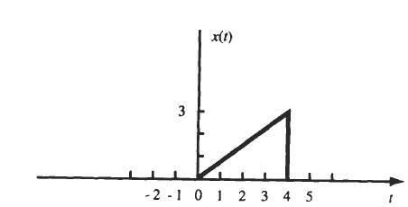
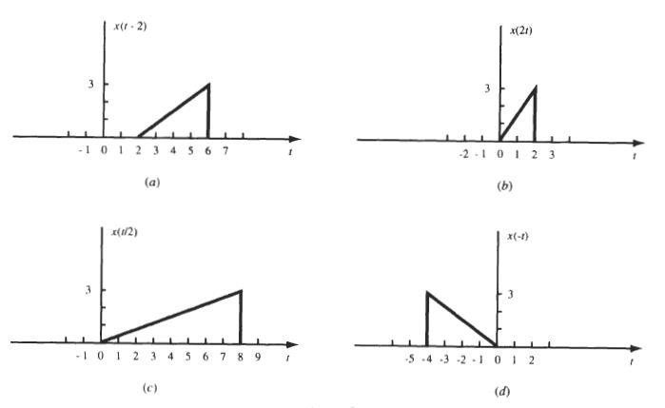
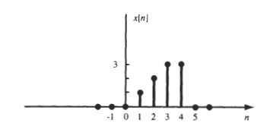
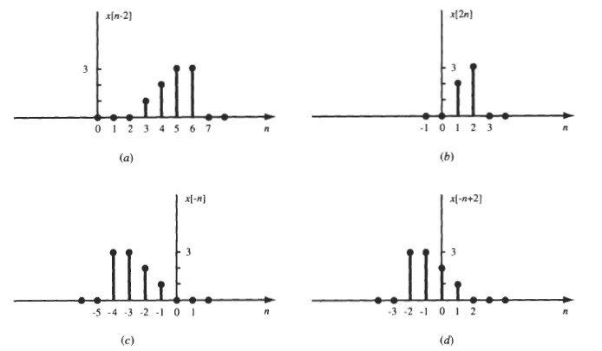
Signal Processing
Lec. 1
Examples Of Signals And Classification Of Signals
1.1. A continuous-time signal x ( t ) is shown in Fig.. Sketch and label each of the following signals.
( a ) x(t - 2); ( b ) x(2t); ( c ) x(t/2); (d) x ( - t )
Sol:
1.2. A discrete-time signal x [ n ] is shown in Fig. Sketch and label each of the following signals.
(a) x[n – 2]; (b) x[2n]; ( c ) x [ - n ] ; ( d ) x [ - n +2] Sol:
Page 10

Slide 11

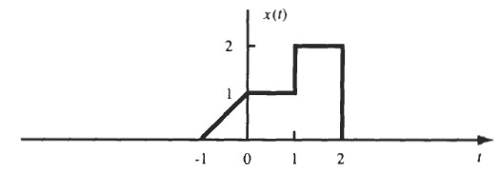

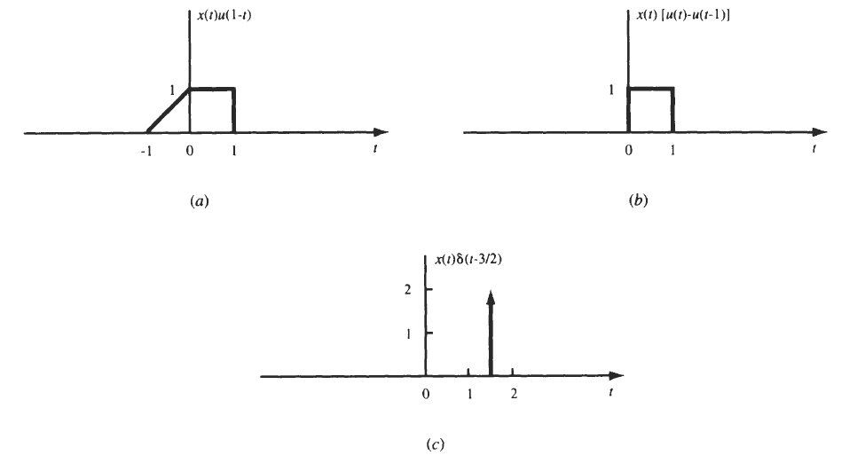
Signal Processing
Lec. 1
1.3. A continuous-time signal x( t ) is shown in Fig.. Sketch and label each of the following signals.
( a ) x ( t ) u ( l - t ) ; ( b ) x ( t ) [ u ( t ) - u(t - 1)]; (c) x ( t ) 𝛿(t -³
)
2
sol:
(a) ∵
Therefor x(t) u(l - t ) is sketched in Fig. (a). ( b ) ∵
Therefor x ( t ) [u( t )- u(t – 1) ] is sketched in Fig. (b).
) ³ ) 𝛿(t - ³ = 2 𝛿(t - ³
) )
2 2 2
2

Slide 12





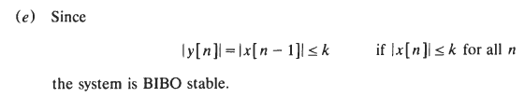

Signal Processing
Lec. 1
Examples of systems and classification of systems
Ex1: system has the input-output relation given by
Show that this system is nonlinear.
Sol:
Thus, the system is nonlinear.
Ex2:The discrete-time system shown in Fig. is known as the unit delay element. Determine whether the system is
( a ) memoryless, ( b ) causal, ( c ) linear (e) stable
Sol: (a) The system input-output relation is given by
Since the output value at n depends on the input values at n - 1, the system is not memoryless.
(b) Since the output does not depend on the future input values, the system is causal.
Thus, the superposition property is satisfied and the system is linear.
H.W 1: A system has the input-output relation given by
Determine whether the system is (a) memoryless, (b) causal, ( c ) linear, (e) stable.

Slide 13
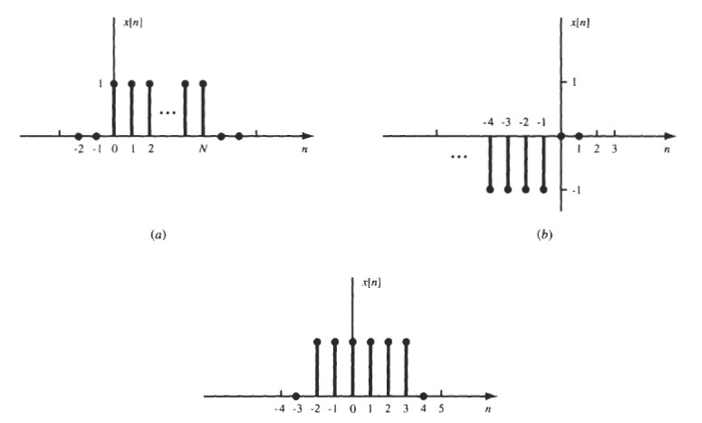
Signal Processing
Lec. 1
H.W2: Express the sequences shown in Fig. in terms of unit step functions.
H.W3: Consider a discrete-time system with the input-output relation Determine whether this system is linear
Example 3: Given the following linear systems,
a. y(n) = 0.5x(n) + 2.5x(n − 2), for n ≥ 0
b. y(n) = 0.25x(n − 1) + 0.5x(n + 1) − 0.4y(n − 1), for n ≥ 0, Determine whether each is causal.
Solution:
Since for n ≥ 0, the output y(n) depends on the current input x(n) and its past value x(n − 2), the system is causal.
Since for n ≥ 0, the output y(n) depends on the current input x(n) and its future value x(n + 2), the system is noncausal.

